Slide 1

Object – Oriented Programming
Group Project
Kadedra Mason, Abigail Bembridge, Kaif Brown

Slide 2
Objectives
Driver
Processing Officer
Jcf Officer

Slide 3

DRIVER

Slide 4
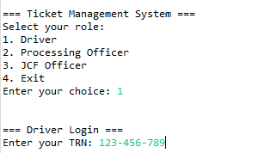
Log in-using trn

Slide 5
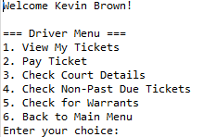
MAIN MENU

Slide 6
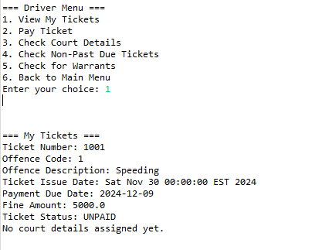
VIEW TICKETS

Slide 7
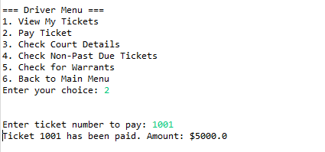
Pay for ticket

Slide 8
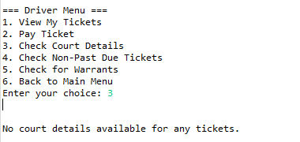
CHECK COURT DETAILS

Slide 9
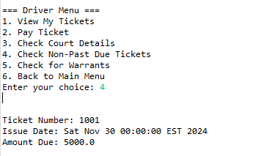
CHECK NON-PAST DUE TICKETS

Slide 10
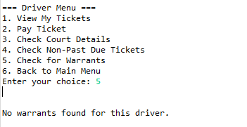
CHECK FOR WARRANTS

Slide 11
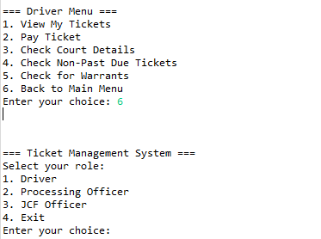
BACK TO MAIN MENU

Slide 12

JCF Officer

Slide 13
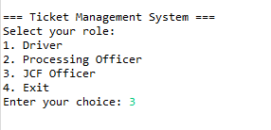
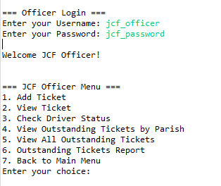
MAIN MENU WITH LOG IN

Slide 14
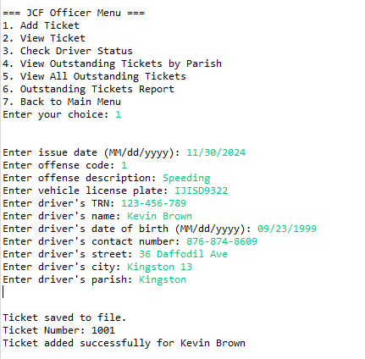
ADD TICKETS

Slide 15
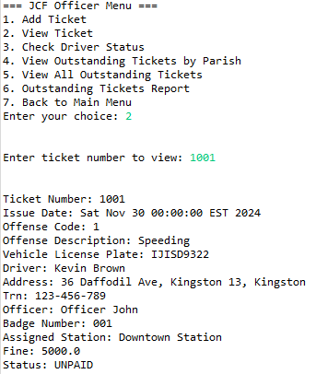
VIEW TICKETS USING TICKET NUMBER

Slide 16
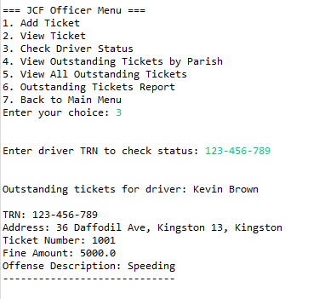
CHECK DRIVER STATUS USING TRN

Slide 17
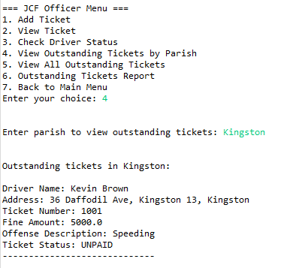
VIEW OUTSTANDING TICKETS IN A PARTICULAR PARISH

Slide 18
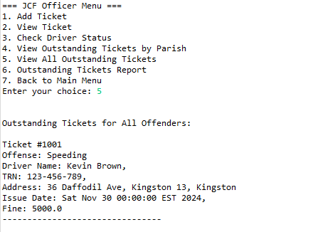
VIEW OUTSTANDING TICKETS FOR ALL OFFENDERS

Slide 19
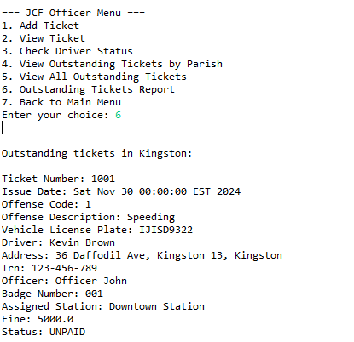
OUTSTANDING TICKETS REPORT ORDERED BY PARISH

Slide 20
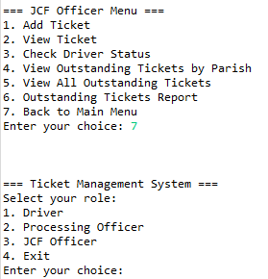
BACK TO MENU

Slide 21

Processing OFFICER

Slide 22
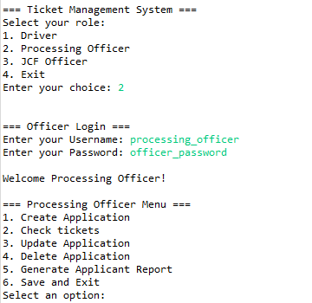
MAIN MENU AND LOG IN

Slide 23
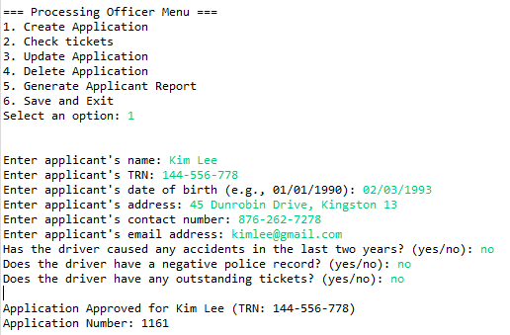
CREATE APPLICATION

Slide 24
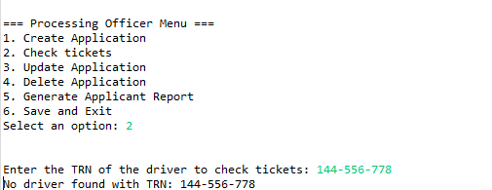
CHECK TICKETS FOR APPLICANT

Slide 25
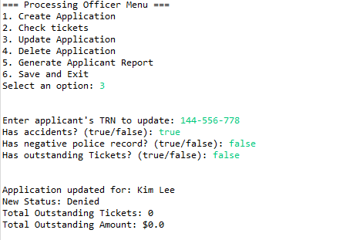
UPDATE APPLICATION

Slide 26
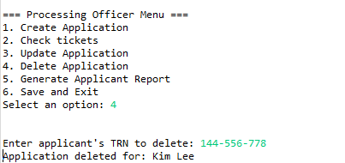
DELETE APPLICATION USING TRN

Slide 27
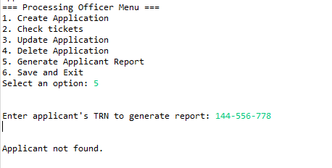
GENERATE REPORT USING TRN

Slide 28
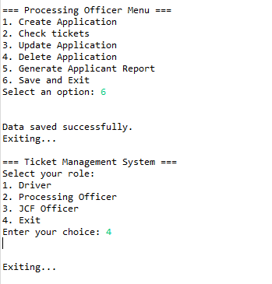
EXITING PROGRAM

